Slide 1
Police tackles gunman on e-bike

Slide 2
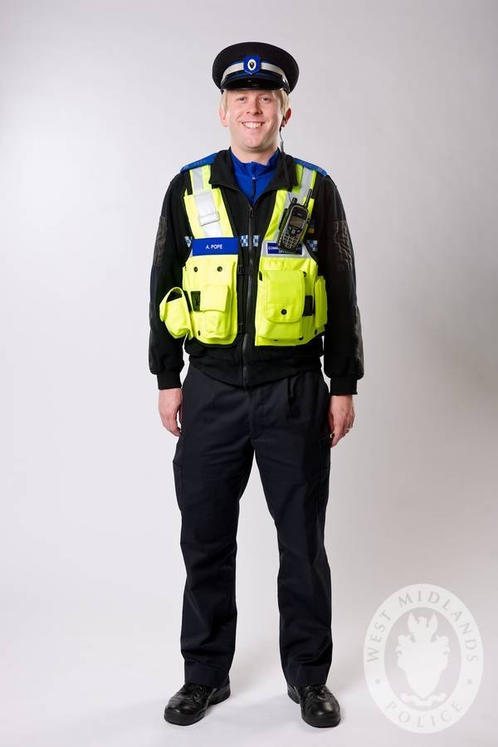
Who?
Antonio Balu
25 years old
West Midlands Police Officers
(Guardian Taskforce)

Slide 3

What?
Arrest of Balu
Carrying a loaded firearm
While riding a black e-bike

Slide 4
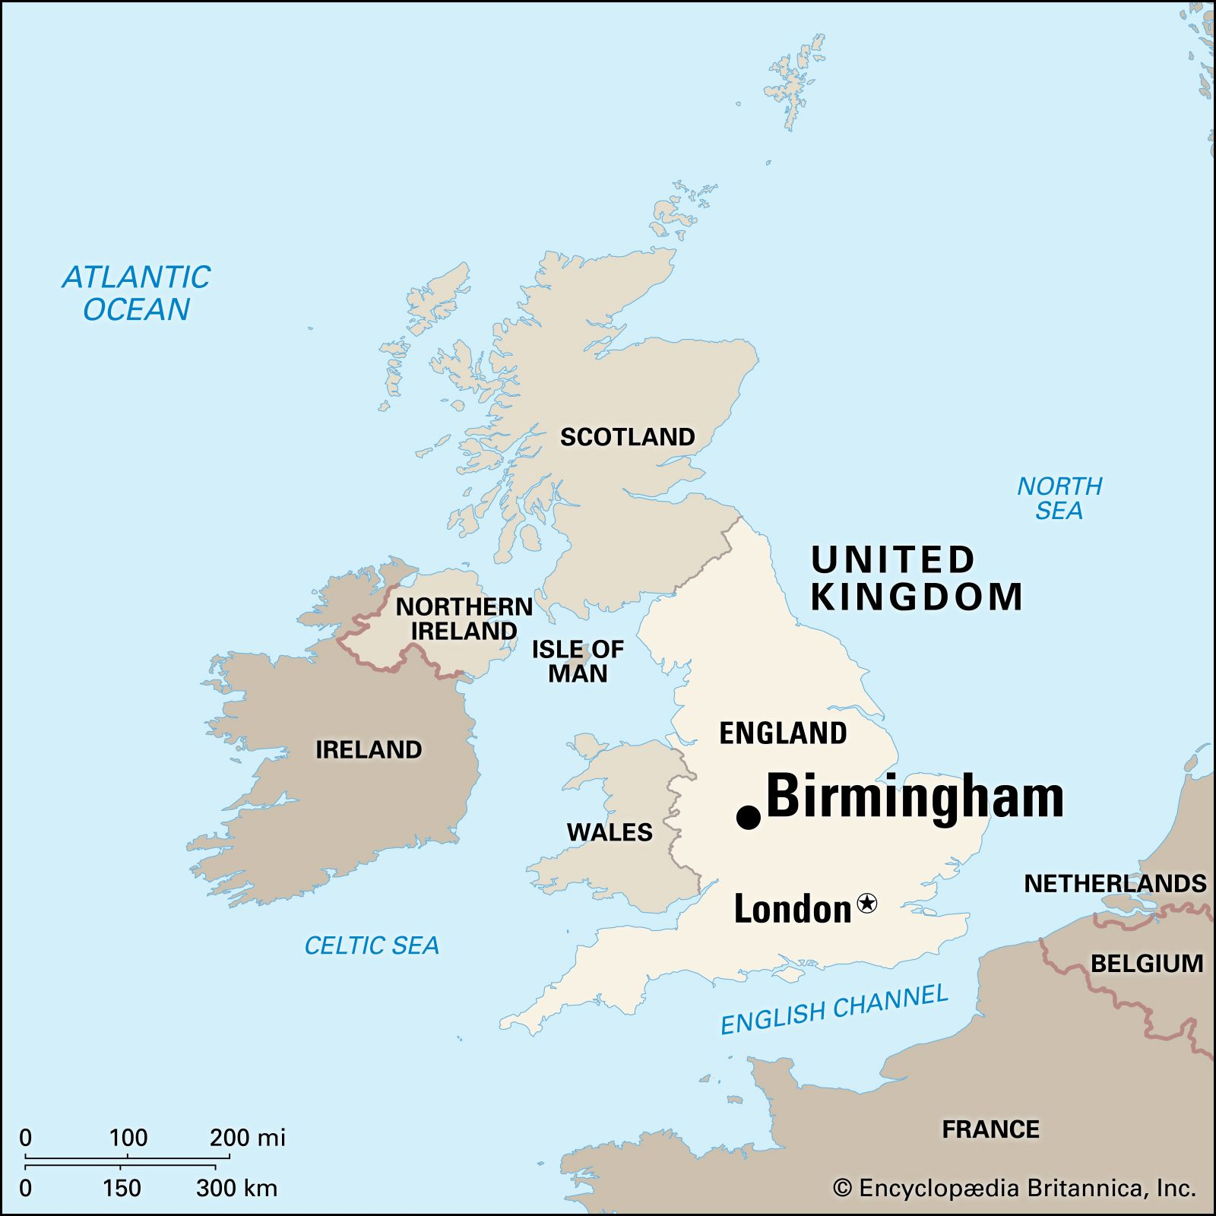
Where?
Soho Road
Birmingham
England

Slide 5
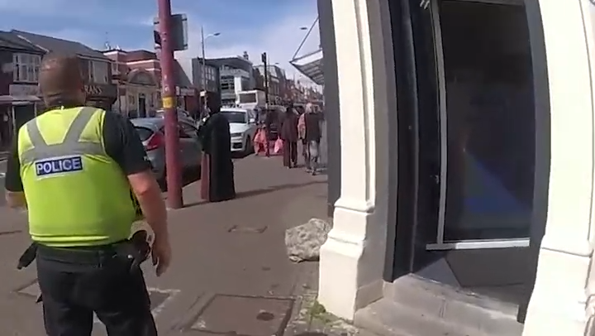
When?
August 13, 2024
Balu was sentenced
November 20, 2024

Slide 6
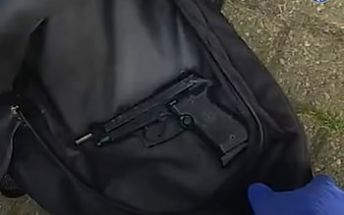
Why?
Antonio Balu
25 years old
West Midlands Police Officers
(Guardian Taskforce)

Slide 7
THE END

